Slide 1
Deploying Egeria
Mandy Chessell, IBM

Slide 2
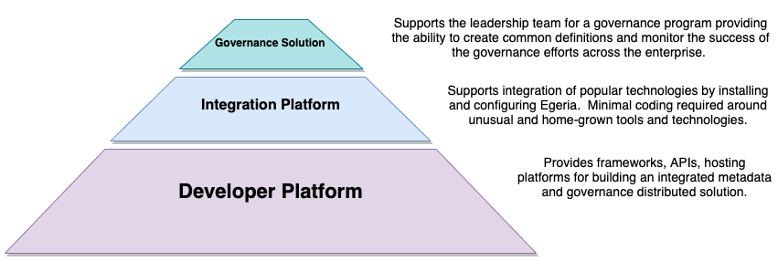
Another way to understand the Egeria capability

Slide 3
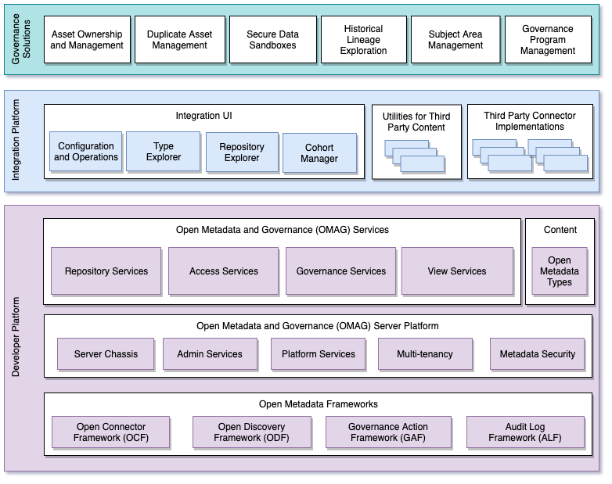
Egeria project structure
Egeria has a modular structure designed for vendors to extend with their value add.
The integration platform and governance solutions exploit the value of the enterprise view provided by the OMAG Services.

Slide 4
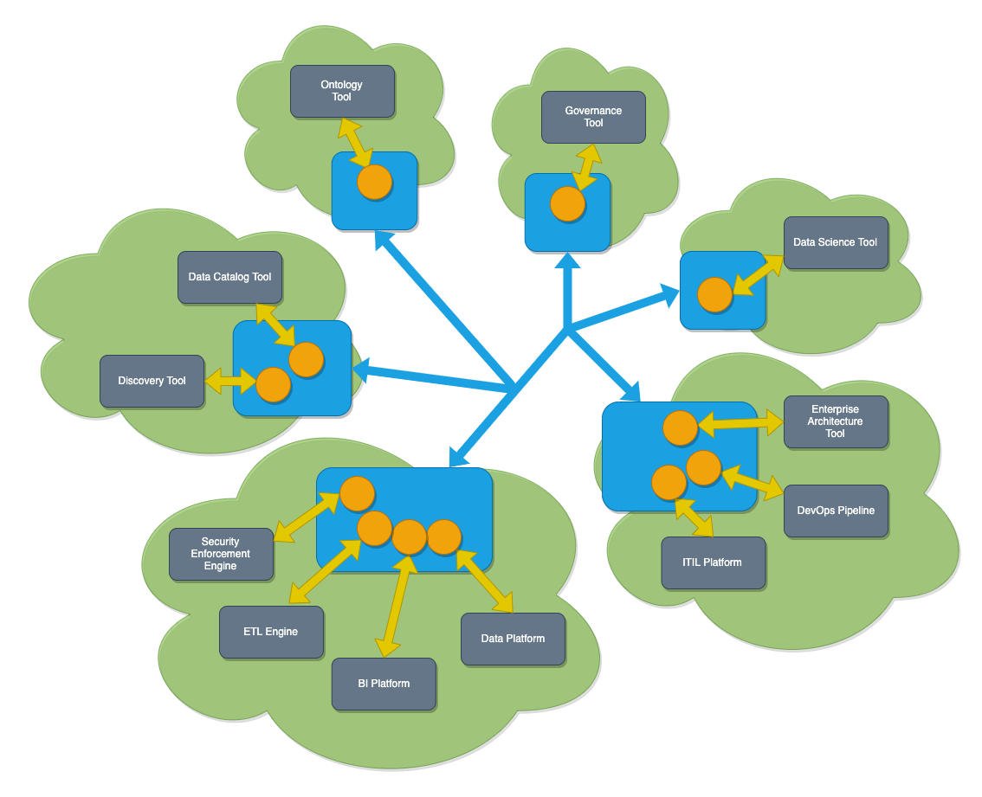
Egeria in operation
Egeria’s platform (in blue) runs in each deployment environment (cloud or on premises)
Egeria servers (orange circles) are deployed on the platform. Each are specialized to support the metadata needs of specific technologies
Egeria manages the exchange of metadata between all parties.

Slide 5
The OMAG Server Platform
OMAG Server Platform
OMAG Server Platform
OMAG Server Platform
OMAG Server Platform
OMAG Server Platform
Multi-tenant
Egeria Server 1
Egeria Server 1
Egeria Server 2
Egeria Server 2
Egeria Server 3
Egeria Server 3
OMAG Server Platform
Egeria Server 1
Edge
Kubernetes

Slide 6
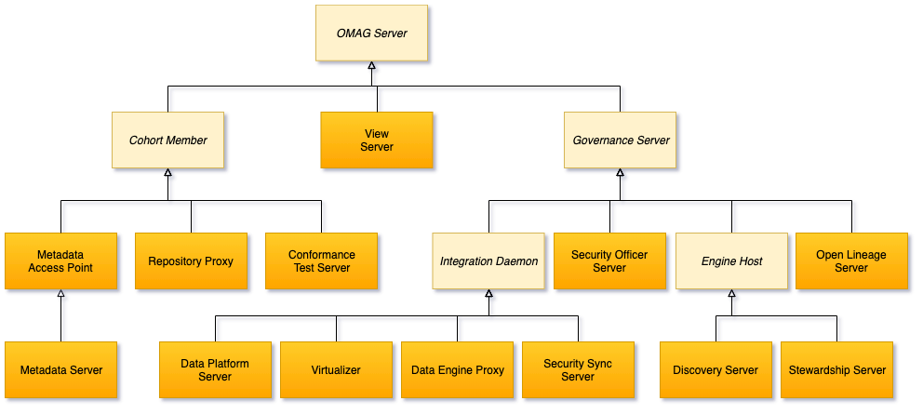
Types of OMAG Servers

Slide 7
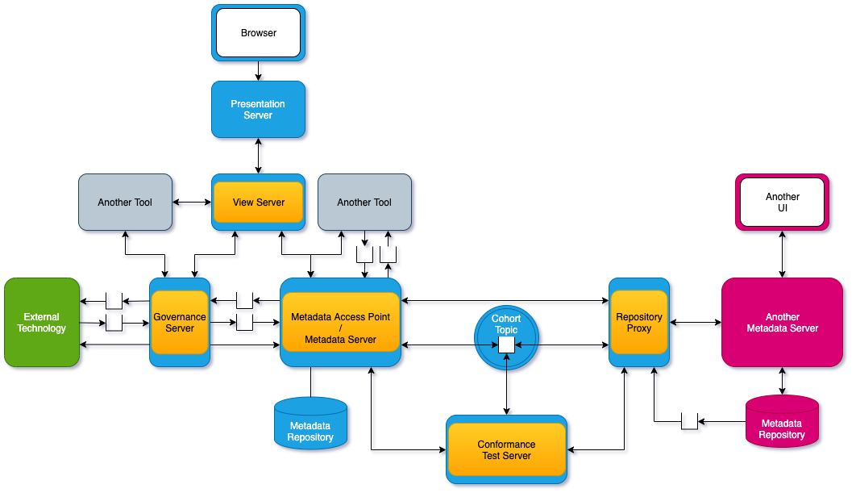
Connected OMAG Servers

Slide 8
A potential deployment of Egeria
Data Virtualization
Virtualizer
Data Lake
Chief Data Office
Metadata Server
Apache Ranger
Security-Sync
Cohort A
Metadata Server
Stewardship
Proxy
Data Platform
Systems of Record
Metadata
Server
Discovery
Stewardship
Data Onboarding

Slide 9
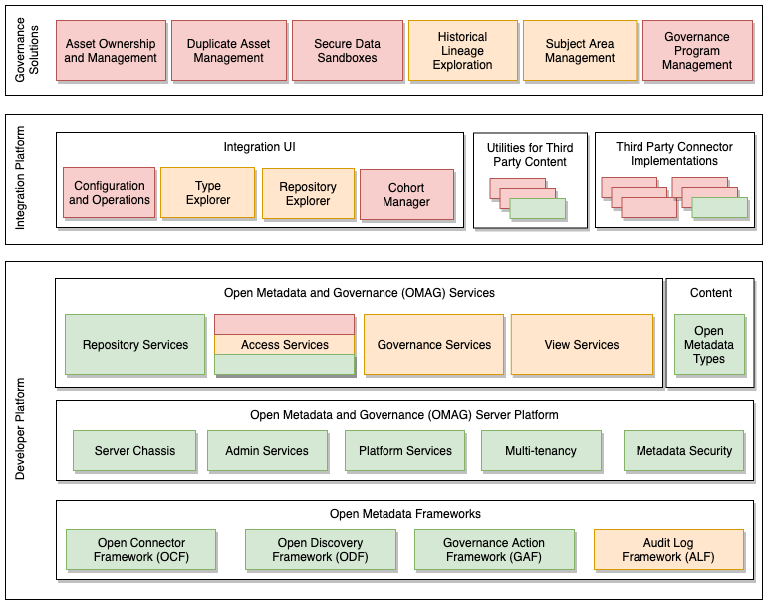
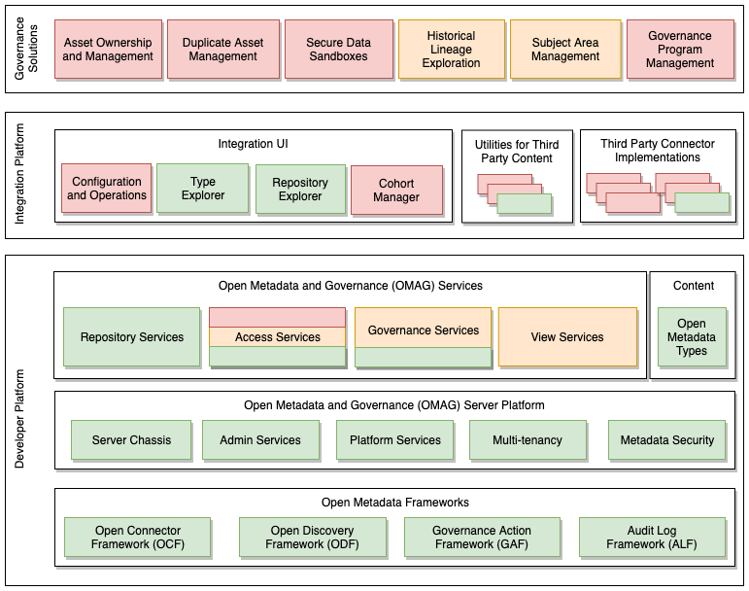
Development Status
Repository Explorer (REX) complements Type Explorer (TEX)
Duplicate Asset Detection
Audit Log Framework (ALF)

Slide 10
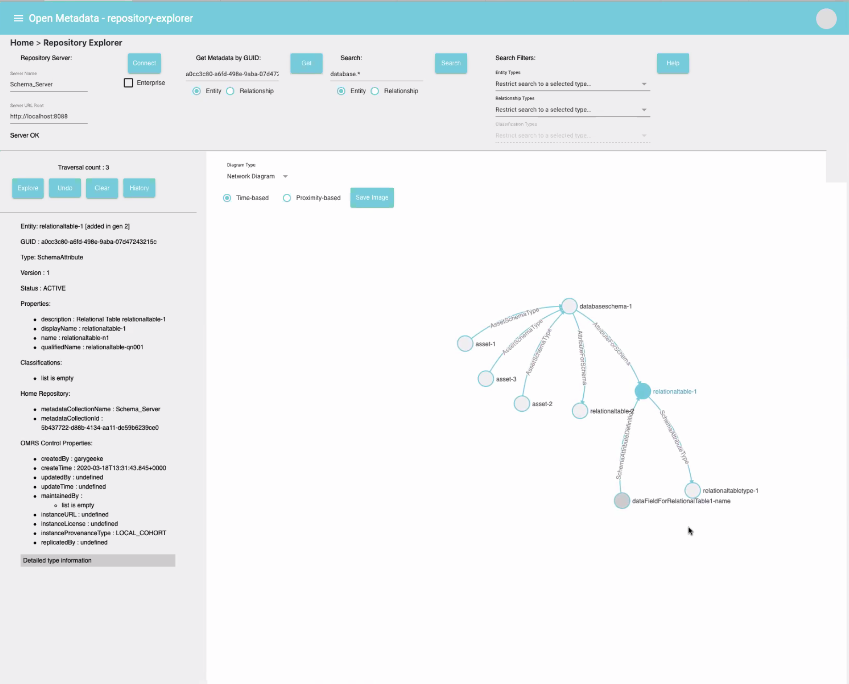
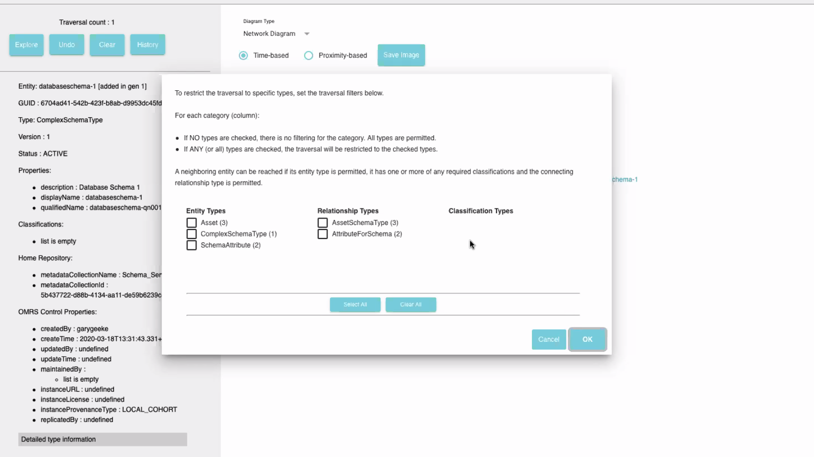
Repository explorer

Slide 11
Taking the next step with ODPi Egeria
Website https://egeria.odpi.org
Links to guides, glossary, history, design docs, …
Kubernetes/Docker deployment
Hands on labs
Coding samples
Guidance on Governance

Slide 12
Open forum
z
z
z
z
z
z
z
Questions?

Slide 13
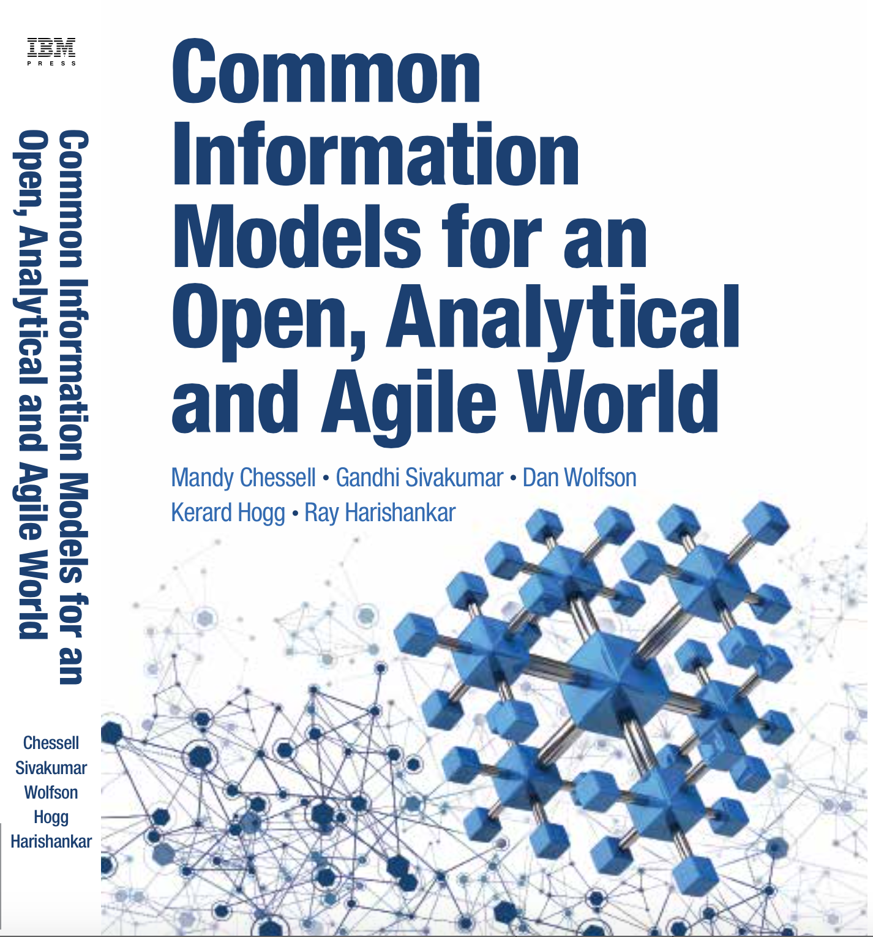
Common Information Models for an Open, Analytical and Agile World
To drive maximum value from complex IT projects, IT professionals need a deep understanding of the information their projects will use. Too often, however, IT treats information as an afterthought: the “poor stepchild” behind applications and infrastructure. That needs to change. This book will help you change it.
Using a complete case study, the authors explain what CIMs are, how to build them, and how to maintain them. You learn how to clarify the structure, meaning, and intent of any information you may exchange, and then use your CIM to improve integration, collaboration, and agility.
In today’s mobile, cloud, and analytics environments, your information is more valuable than ever. To build systems that make the most of it, start right here.

Slide 14
Links
Press Release and Podcast
Open source repositories
https://www.linuxfoundation.org/press-release/2018/08/odpi-announces-egeria-for-open-sharing-exchange-and-governance-of-metadata/
https://roaringelephant.org/2018/09/25/episode-107-open-metadata-and-governance-masterclass-with-mandy-chessell-part-1/
https://roaringelephant.org/2018/10/09/episode-109-open-metadata-and-governance-
masterclass-with-mandy-chessell-part-2/
https://github.com/odpi/data-governance
https://github.com/odpi/egeria

Slide 15
